Slide 1




Arpit Tamrakar

Slide 2

Vidarbha data weather forecasting using machine learning algorithm integrated with power bi dashboard

Slide 3
NEED OF THE PROJECT
• Accurate Weather Prediction for Agriculture: Maharashtra heavily relies on agriculture, with a substantial portion of its population engaged in farming. Accurate weather forecasts are crucial for making informed decisions regarding planting, irrigation, and harvesting, which can significantly impact crop yields and farmer income.
• Natural Disaster Preparedness: Maharashtra is prone to various weather-related challenges like monsoons, cyclones, and heatwaves. A sophisticated weather forecasting system aids in predicting these extreme events more accurately, allowing authorities to take proactive measures for disaster preparedness, evacuation, and resource allocation.
• Infrastructure and Resource Management: Weather plays a pivotal role in managing resources such as water, electricity, and transportation. Accurate predictions assist in managing reservoirs, optimizing energy production, and planning for potential disruptions caused by adverse weather conditions.
• Tourism and Travel Planning: Tourism is a major contributor to Maharashtra's economy. A reliable weather forecasting system benefits both tourists and tourism agencies by providing accurate weather information, enabling better itinerary planning and enhancing visitor experiences.
• Public Awareness and Safety: Timely and accurate weather forecasts contribute to public safety by informing individuals about impending weather conditions. This empowers citizens to take precautions, such as staying indoors during heavy rains or avoiding travel during severe weather, ultimately reducing the risk of accidents and casualties

Slide 4
Working on the Gathered DataSets

Slide 5
Functions Used
Pandas head() method is used to return top n (5 by default) rows of a data frame or series. Pandas tail() method is used to return bottom n (5 by default) rows of a data frame or series. Pandas Shape() property is used to get a tuple representing the dimensionality of the Pandas Data Frame. Pandas columns() attribute to return the column labels of the given Data frame. Pandas info() function is used to get a concise summary of the data frame. Pandas describe() is used to view some basic statistical details like percentile, mean, etc. of a data frame or a series of numeric values.

Slide 6
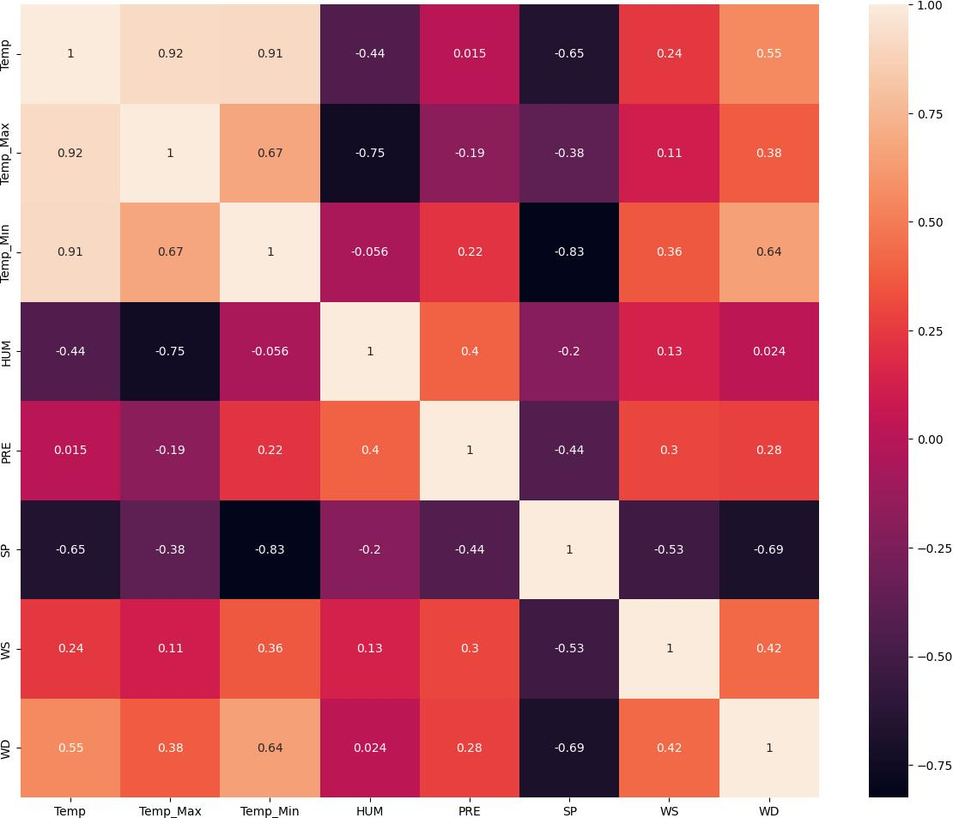
Correlation matrix
This is correlation matrix we are using Seaborn package Library to plot this matrix this is going to give us how each column which are present inside the dataset are correlated to each other, correlated values are always positive if they are highly correlated.

Slide 7
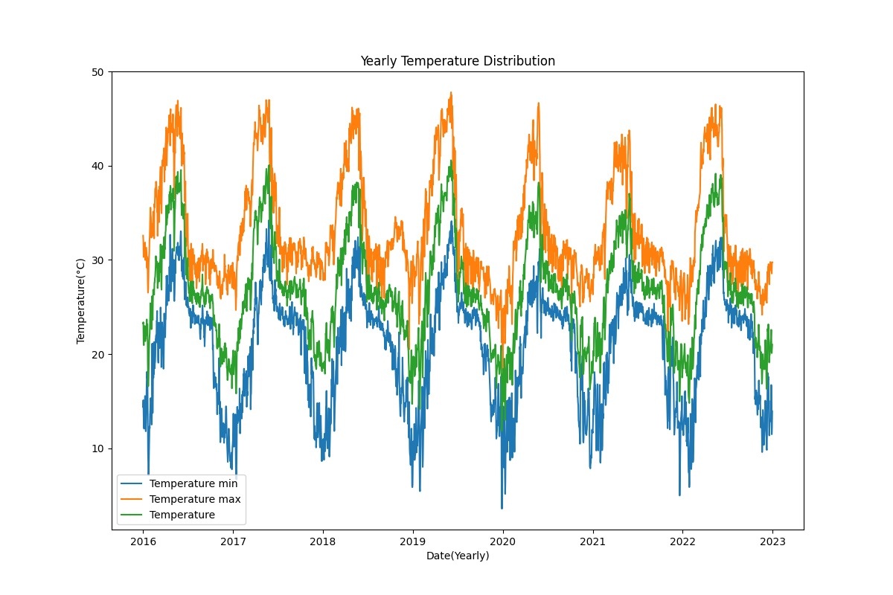
Yearly Temperature Distribution

Slide 8
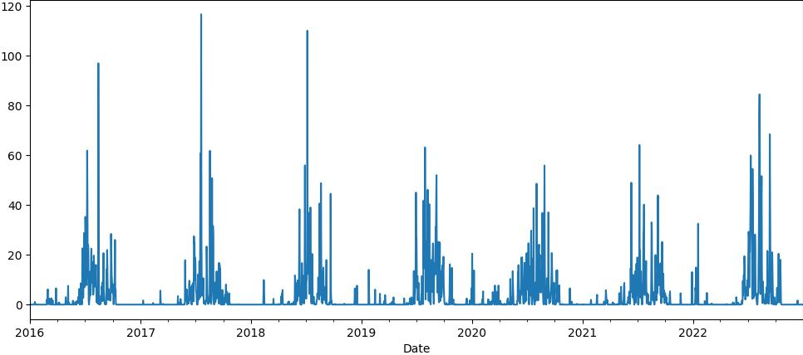
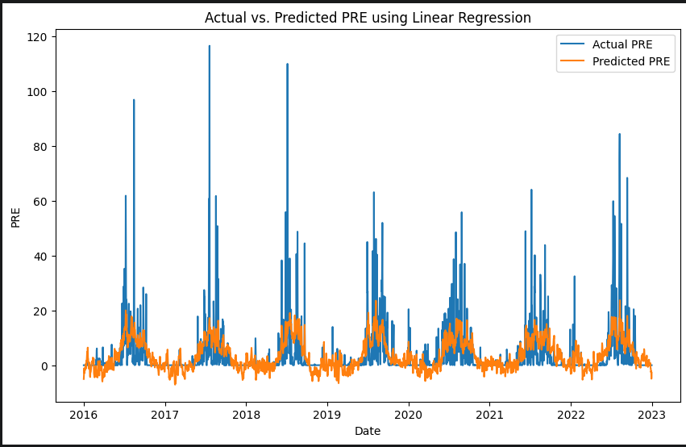
Precipitation

Slide 9
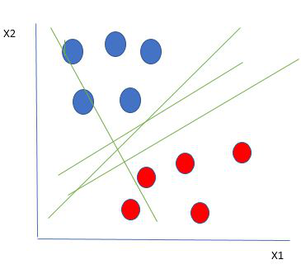
SVM – Support Vector Machine
Support Vector Machine (SVM) is a supervised machine learning algorithm used for both classification and regression. Though we say regression problems as well it’s best suited for classification. The main objective of the SVM algorithm is to find the optimal hyperplane in an N-dimensional space that can separate the data points in different classes in the feature space

Slide 10
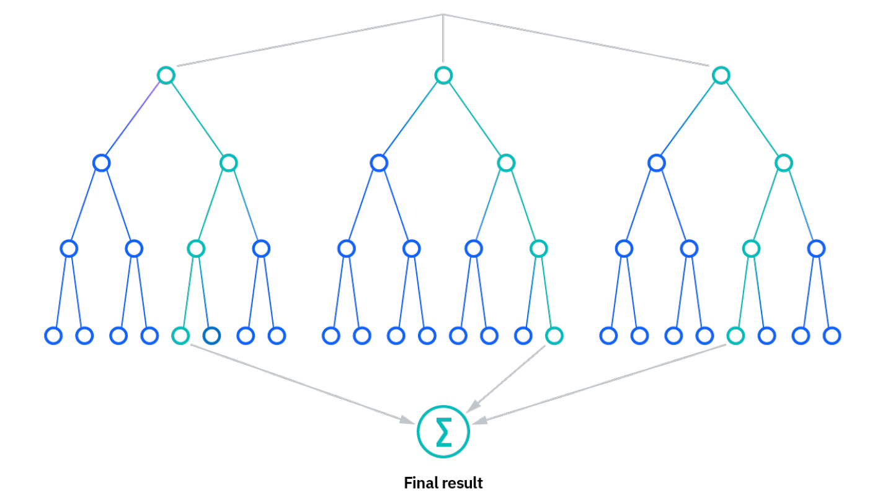
Random Forest
Random forest is a commonly-used machine learning algorithm trademarked by Leo Breiman and Adele Cutler, which combines the output of multiple decision trees to reach a single result.

Slide 11
XGBoost
XGBoost is a robust machine-learning algorithm that can help you understand your data and make better decisions. XGBoost is an implementation of gradient-boosting decision trees.

Slide 12
Working with PoweBI

Slide 13

Power BI
What is Power BI?
Microsoft’s Power BI is a business and data analytics service that enables professionals to process, analyze, and visualize vast volumes of data. It helps extract insights, draw conclusions, and share results in the form of reports and dashboards across various departments. It provides an easy drag and drops feature with a range of interactive data visualizations to generate reports and dashboards.
Features of Power BI
Power BI is faster and performs better when there is a smaller volume of data
Power BI provides an interface based on Microsoft Office 365 that is user-friendly, intuitive, and easy to understand.

Slide 14
More Algorithms to use in Future…
Arima LSTM

Slide 15

Thank You!

